Slide 1
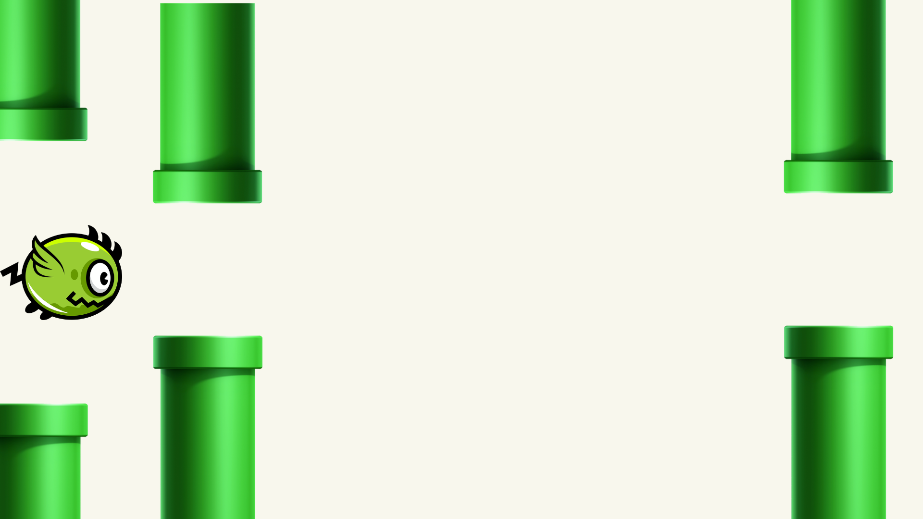
A PROJECT FINAL DEFENSE ON
FLAPPY BIRD
Presentation by :-
Dewanand Giri
Ayush Bhattarai
Uday Shrestha
Om KC

Slide 2
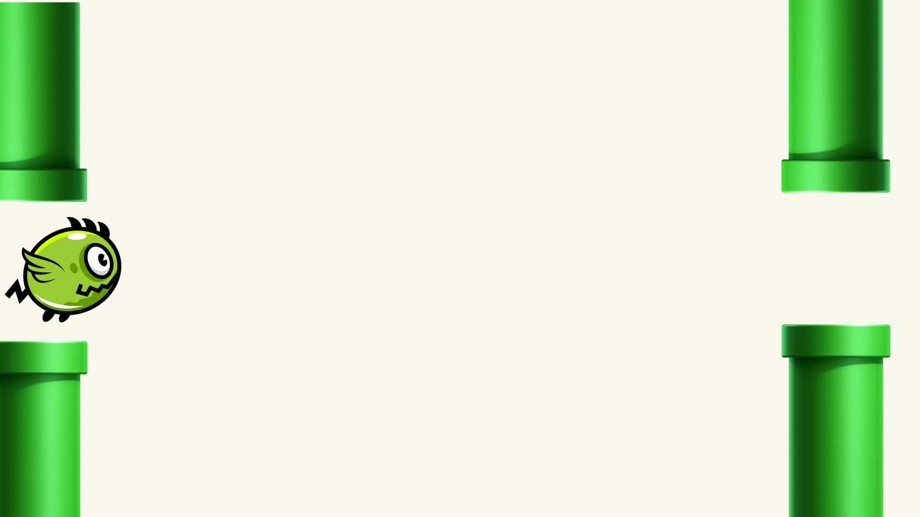
Table Of Content
Introduction
Problem Statement
Objectives
Scope
Block Diagram
Background Study
Literature Review
Requirement Analysis
Feasibility Analysis
Algorithm
slide 1
Slide 1

Slide 3

Table Of Content
Flowchart
Result
Test Cases
Limitation
Future Work
Recommendation
Conclusion
slide 1
Slide 2

Slide 4
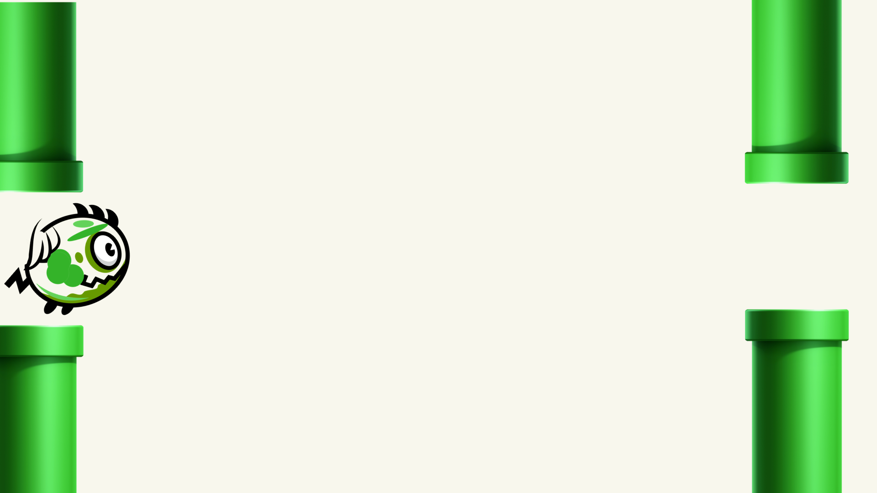
Introduction
Fun to play.
Addictive
Clear and Simple objective
Adrenaline and Dopamine
Emotional attachment
Ported using C++
Great flexibility
Slide 2
Slide 2

Slide 5
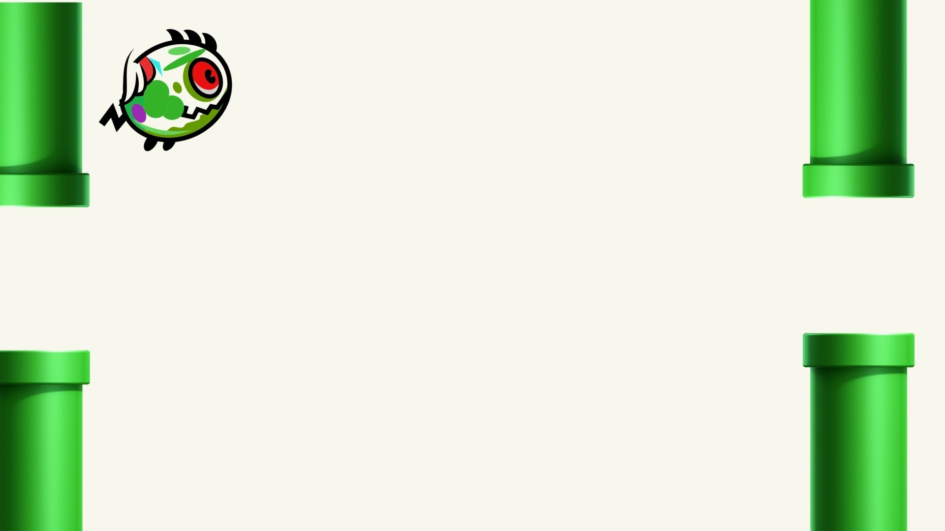
Problem Statement
Living for your loved ones.
Rat race
Regular breaks for mental health
Accessible
Excitement and satisfaction
Release of essential hormones
Slide 3
Slide 3

Slide 6
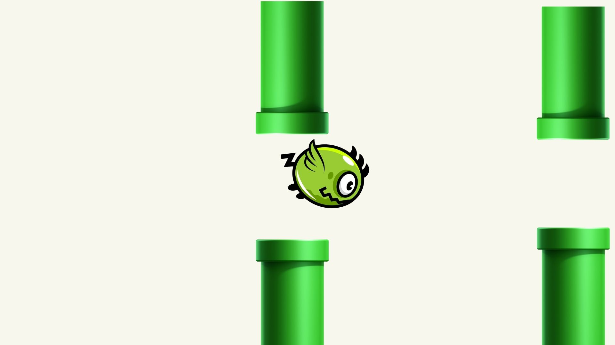
Objectives
Clean, fun and stress free life
Make Flappy bird accessible to all
Utilize knowledge of Object Oriented
programming.
Slide 4
Slide 4

Slide 7
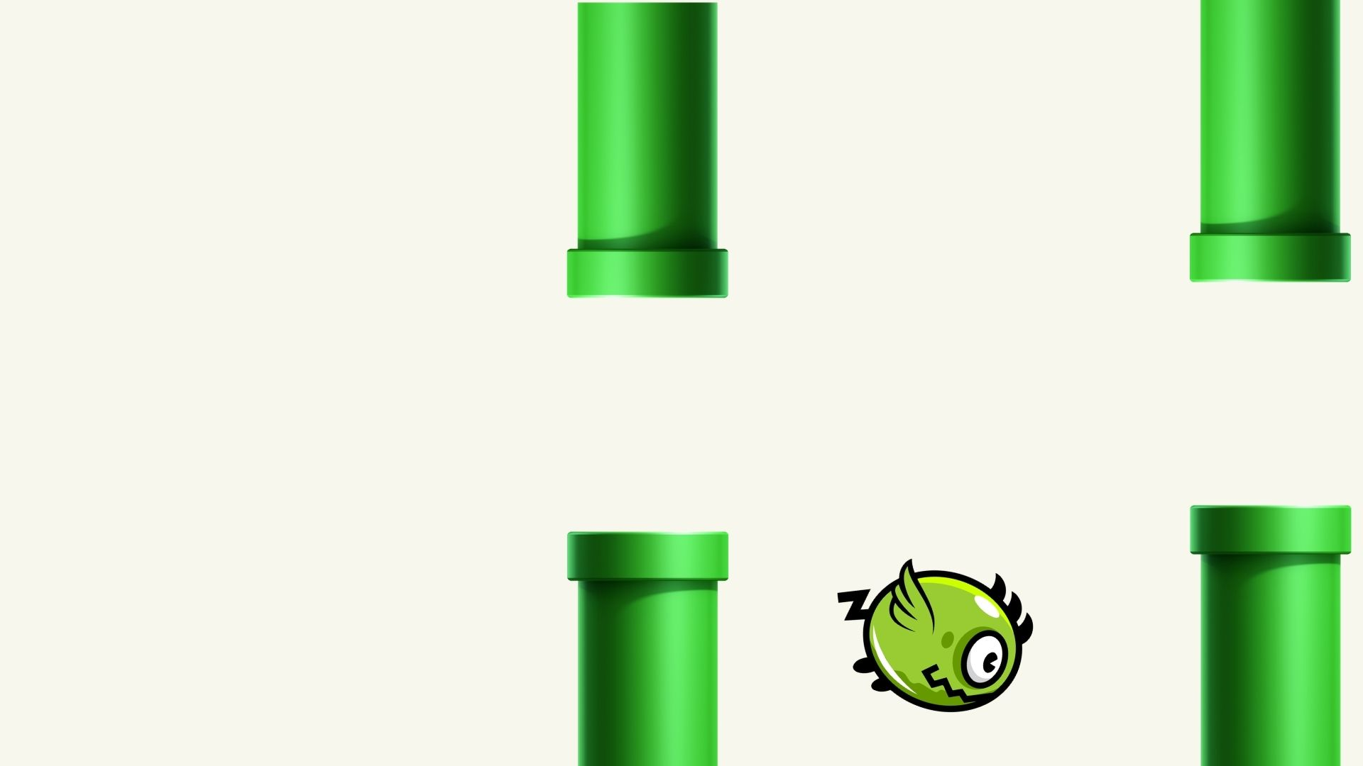
Scopes
People of all ages can enjoy
this game.
Slide 5
Slide 5

Slide 8
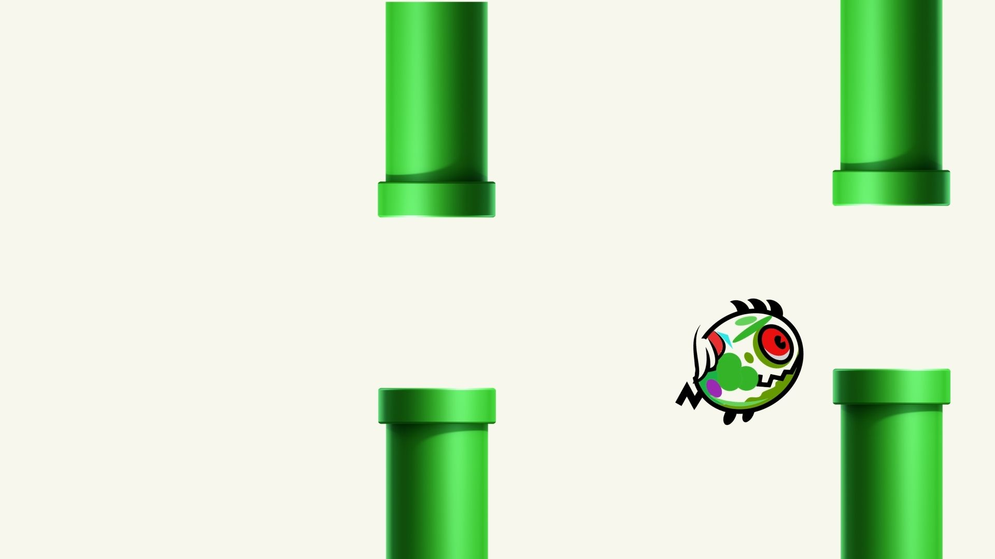
Background Study
Well liked game
Beginner level knowledge of OOP
OpenGL, something new..
Slide 6
Slide 6

Slide 9
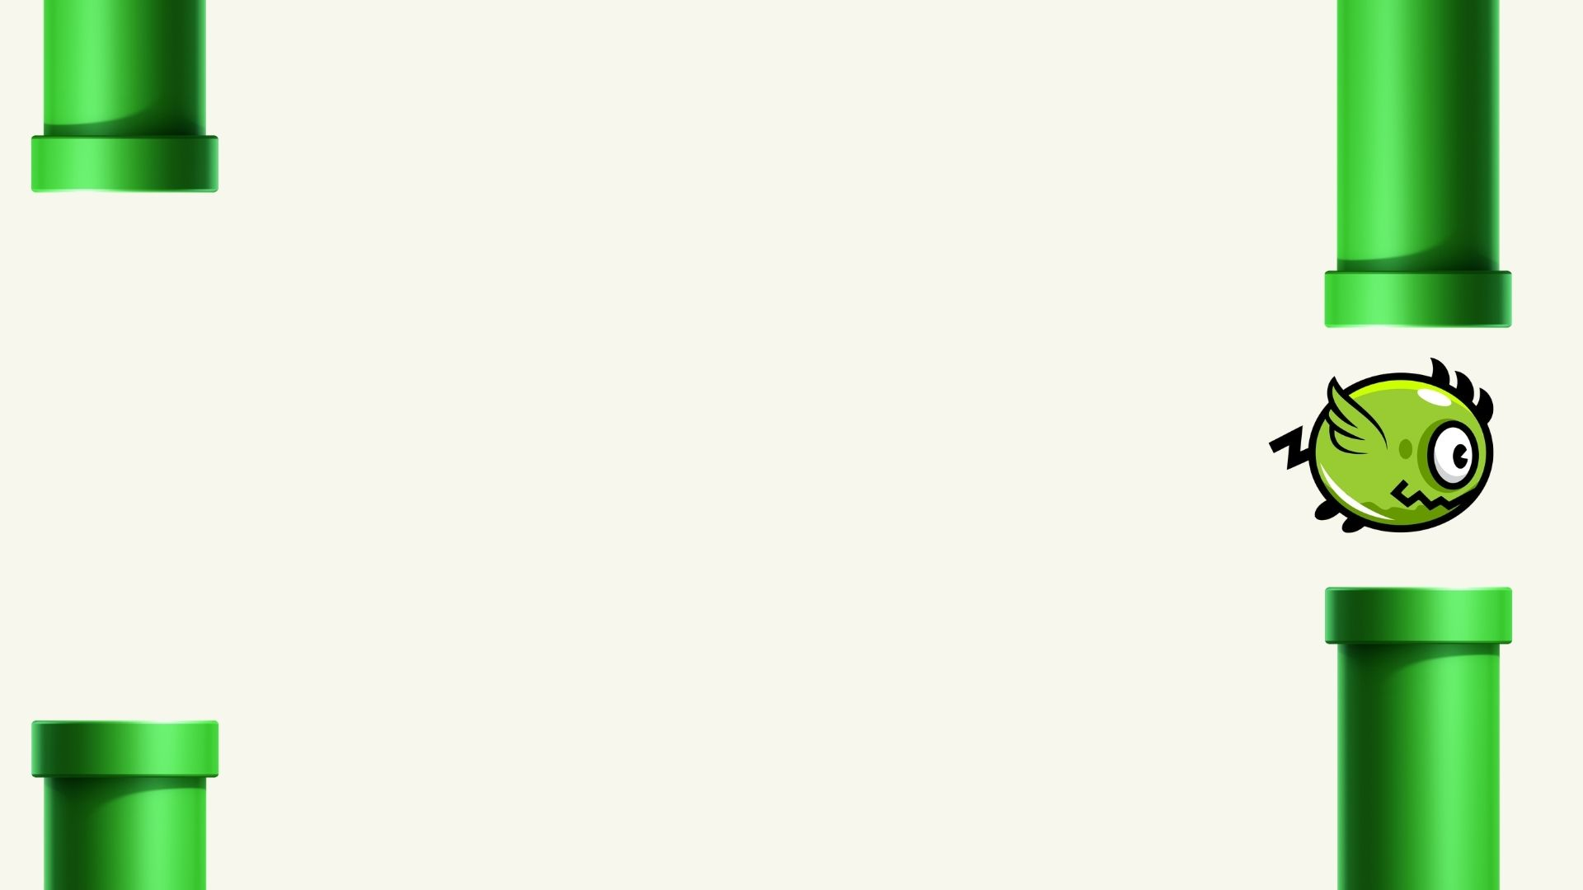
Literature Review(1)
G.Stevens
Irresitable gameplay needs amalgam and hassle.
Game needs to maintain the “flow”..
S.Roth
Basics of software entropies
Broken WIndow Theory
Slide 7

Slide 10
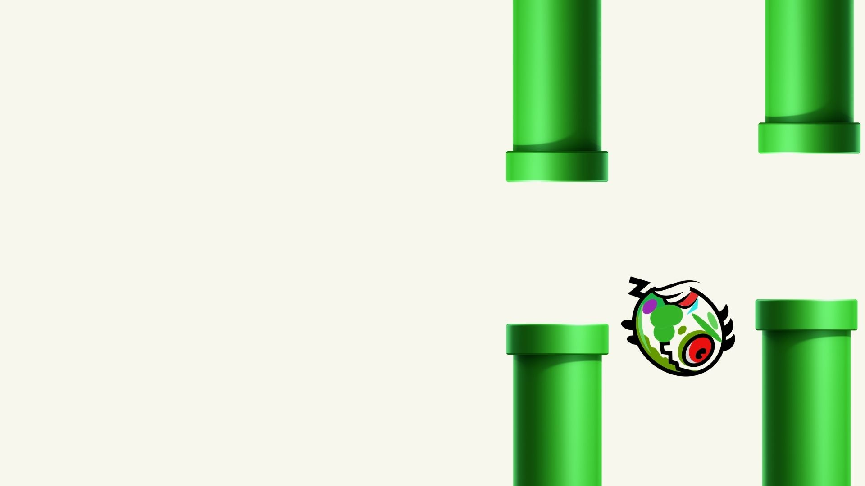
Literature Review(2)
GameDev.net
Vector is core to game development.
Positioning needs vector.
Technical.ly
Goal is a optimal gameplay.
Users know what’s going on in the game.
Slide 8

Slide 11
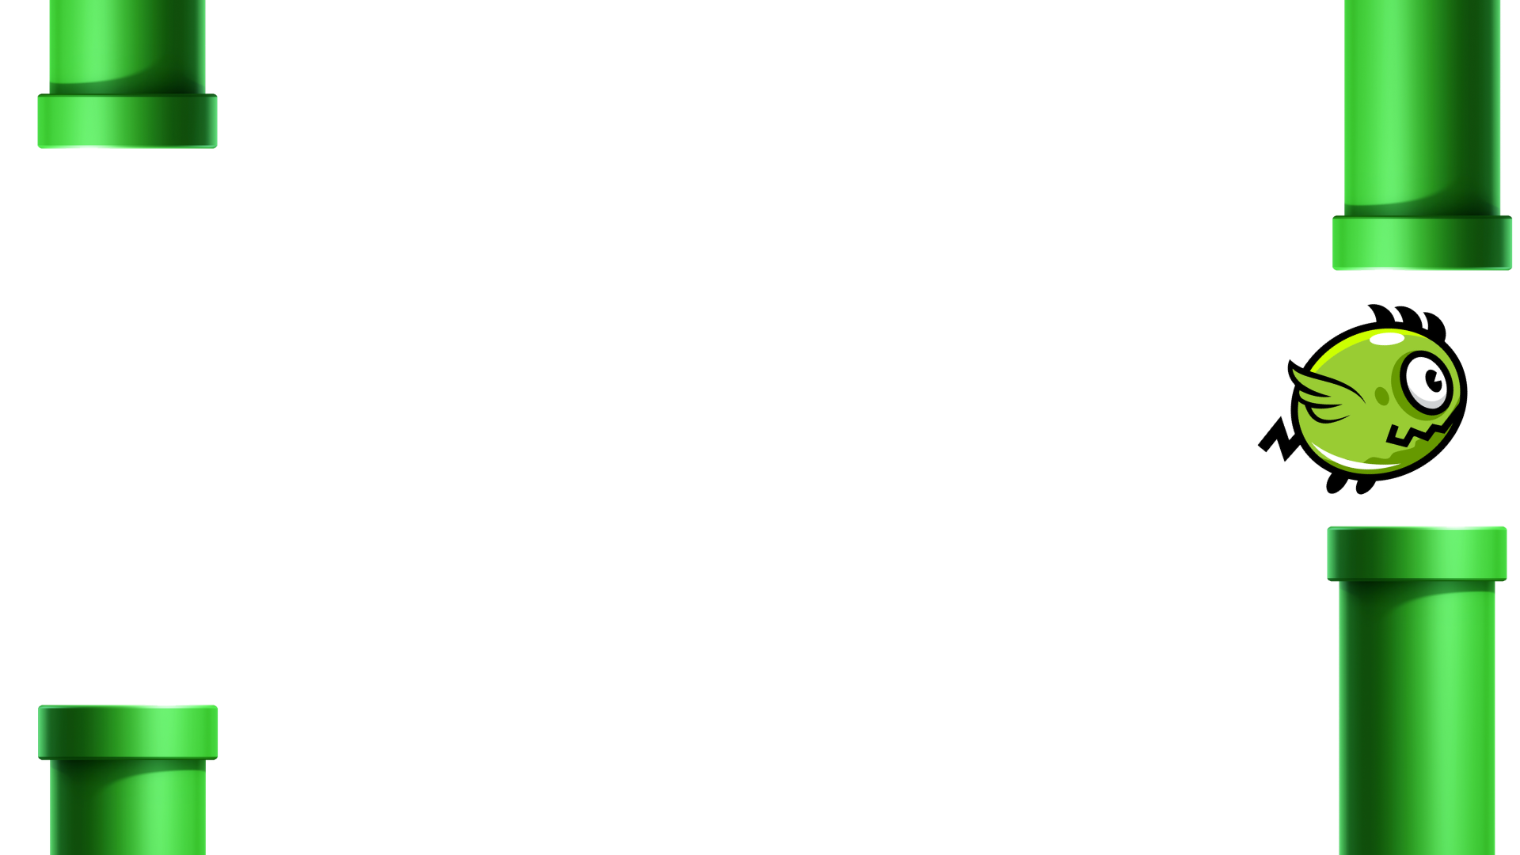
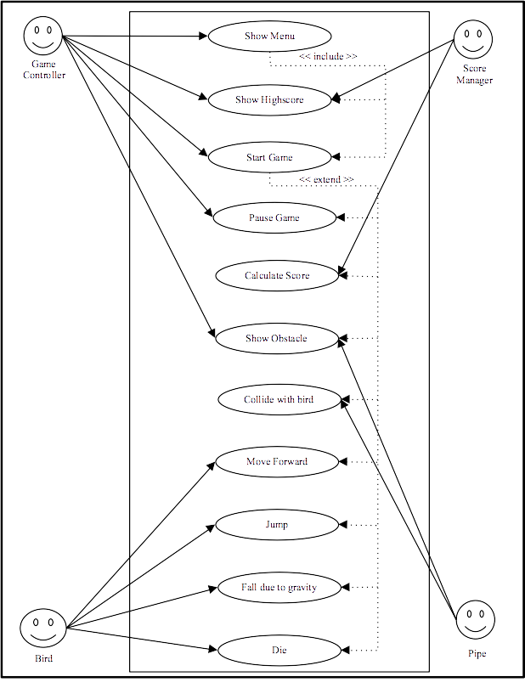
Requirement Analysis
Functional Requirement
Fig: Use case diagram for the project
Slide 8

Slide 12
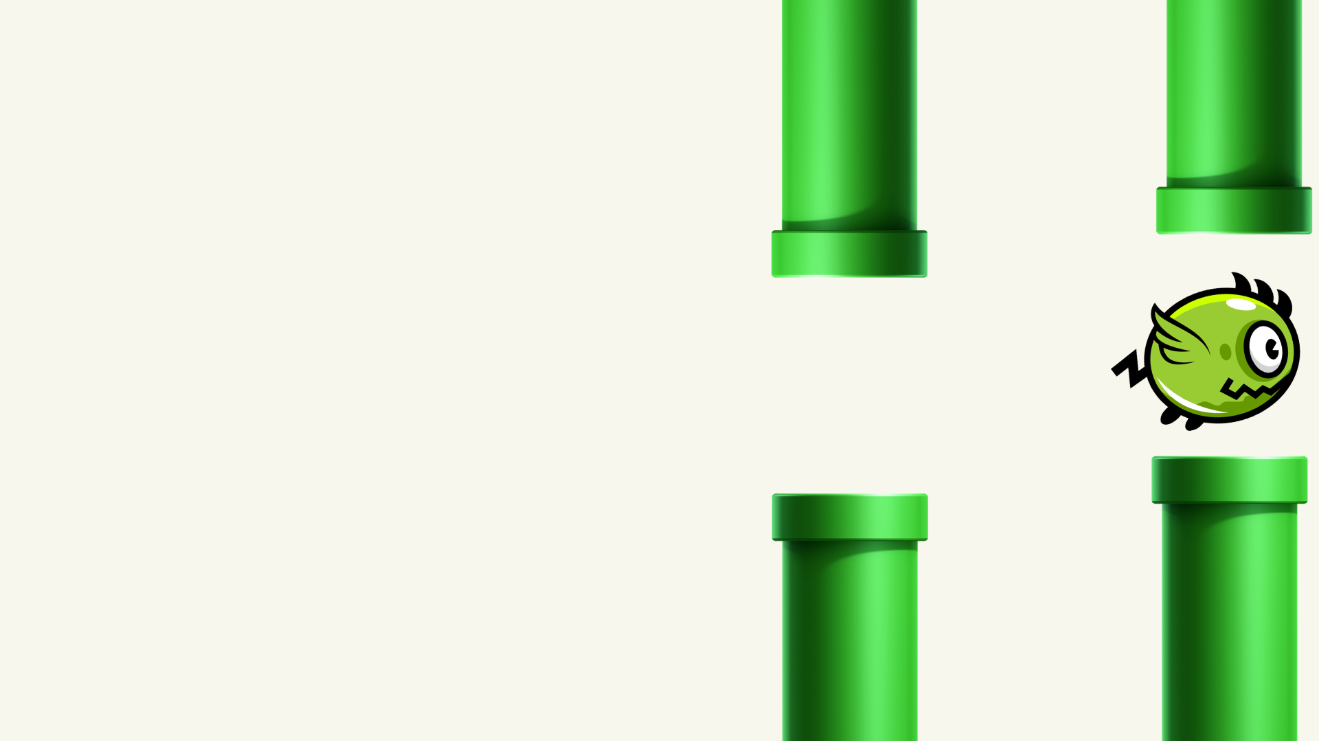
Requirement Analysis
Non-functional requirement
Accessibility
Performance
Appearance
Slide 9

Slide 13
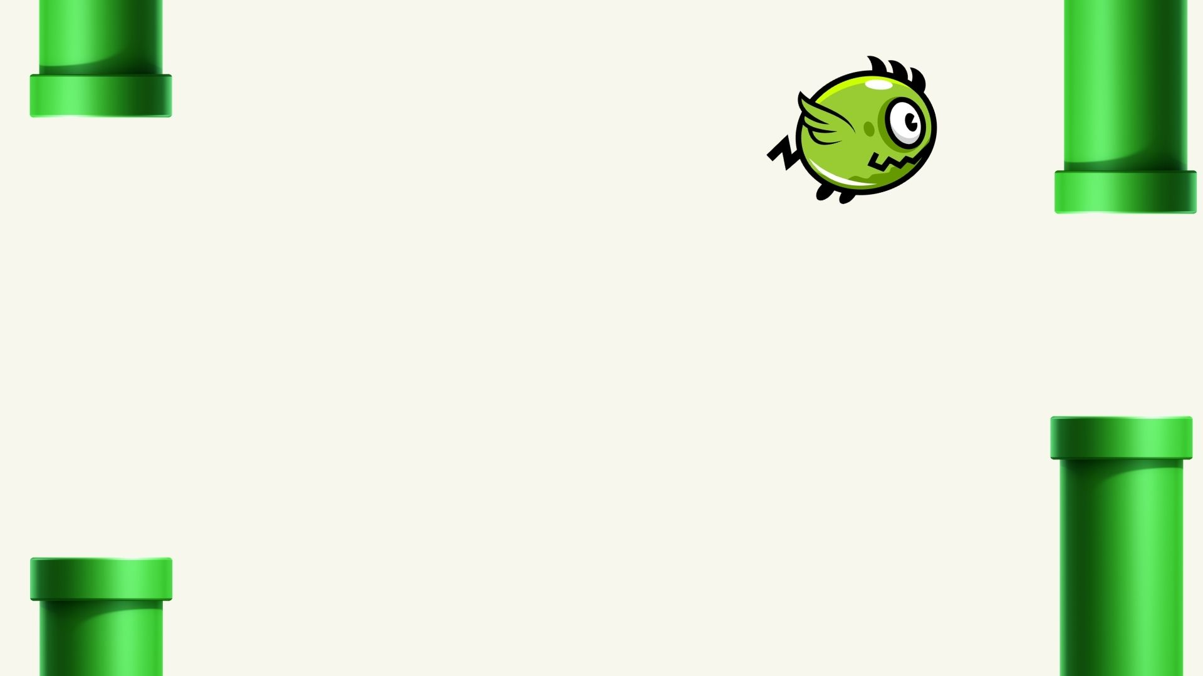
Feasibility Analysis
Technical Feasibility
Operational Feasibility
Economic Feasibility
Schedule Feasibility
Slide 10

Slide 14
Algorithm
Start
Show the welcome screen.
Ask for the key press.
Show obstacle.
If bird collides with pipe go to STEP 7.
If bird does not collide with pipe go to STEP 6.
Increase score counter by 1 & go to STEP 4.
Show welcome screen with the highest score recorded up to that point.
End
Slide 10

Slide 15
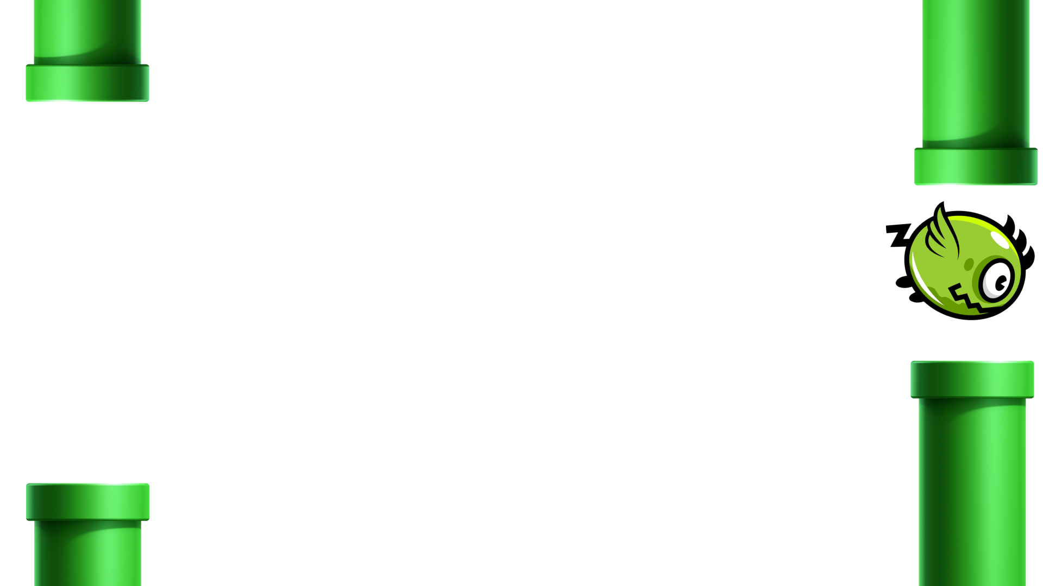
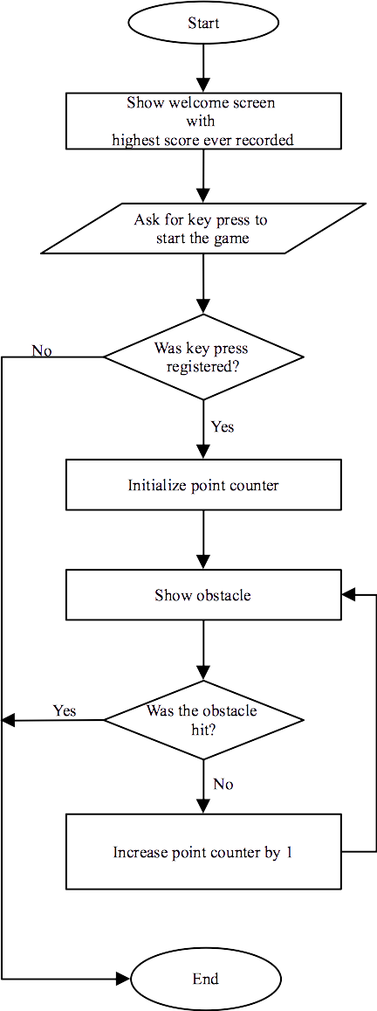
Flowchart
Slide 10

Slide 16
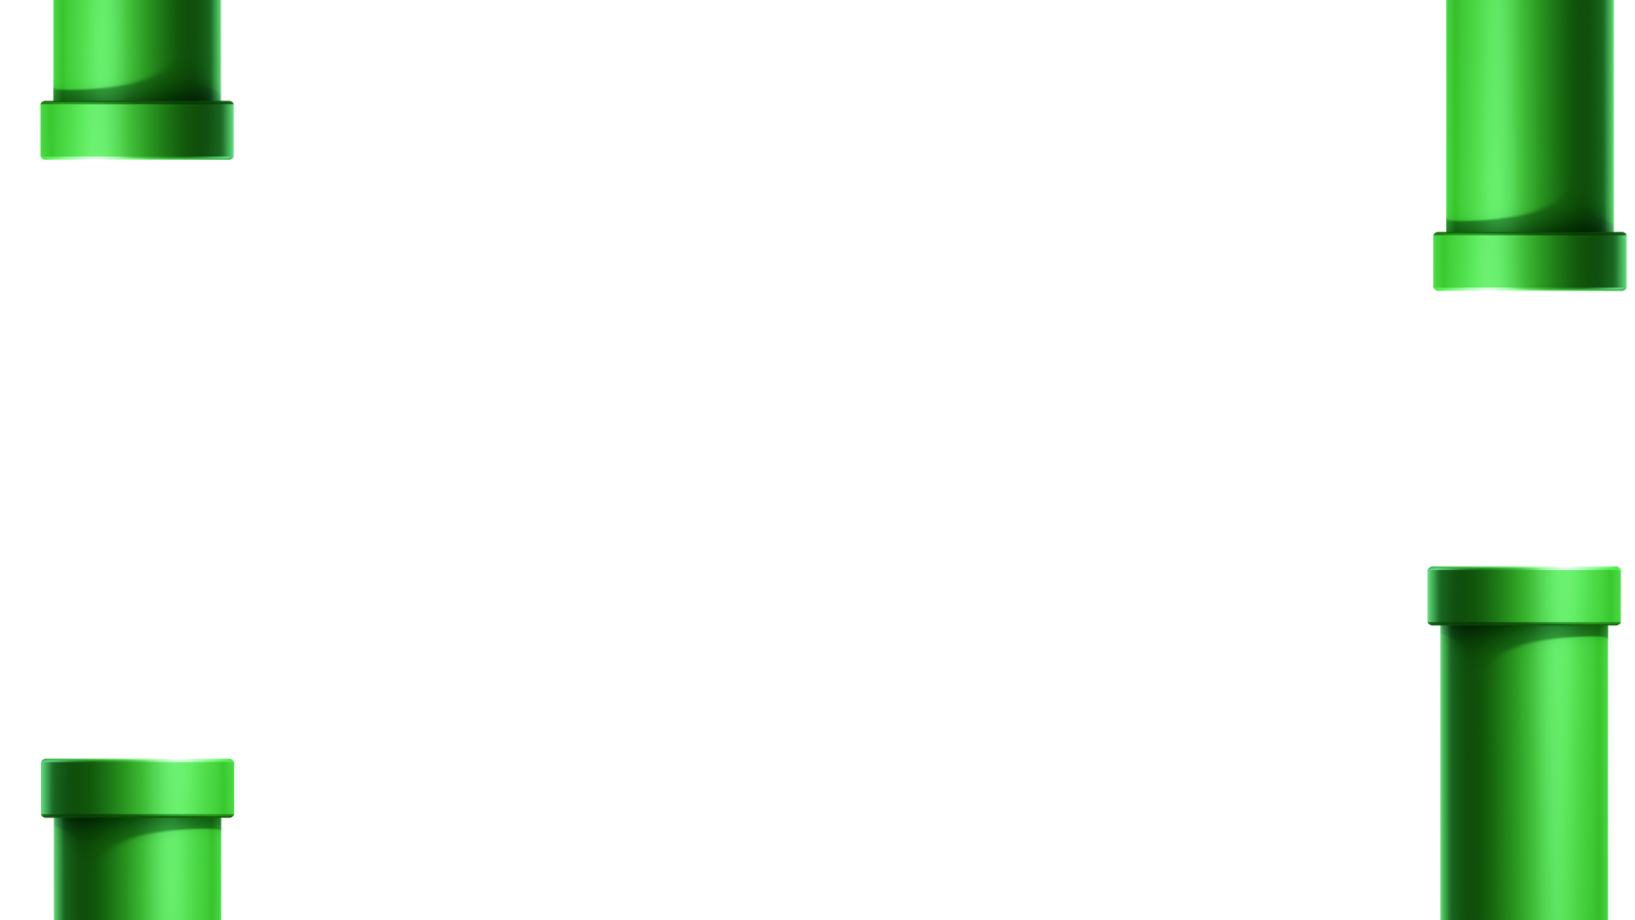
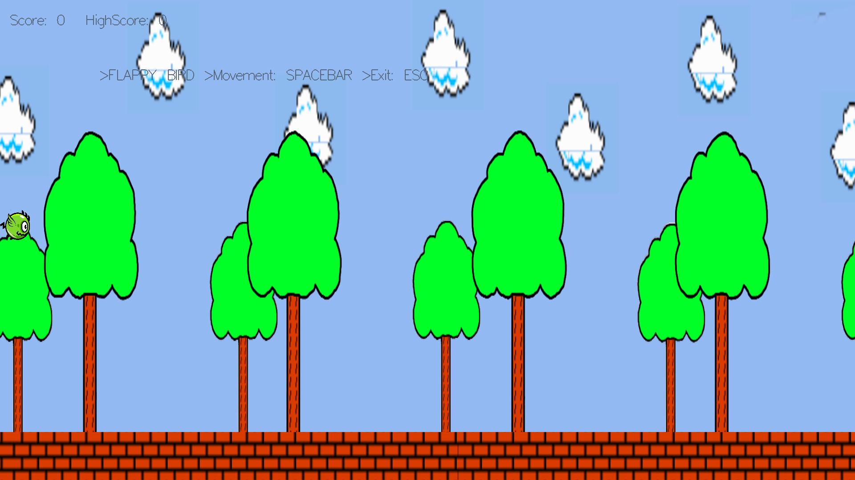
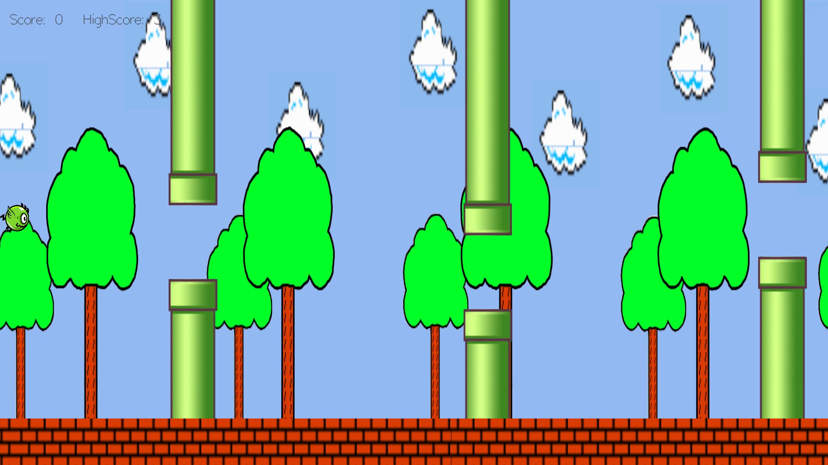
Result
Fig: Screenshot of menu screen
Fig: Screenshot of game screen
Slide 10

Slide 17
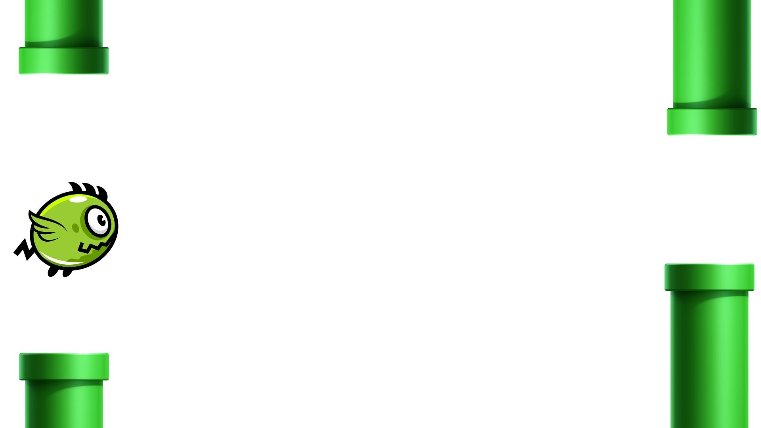
Test Cases
Test Case ID | LOAD_001
Test Case Description | Showing of main screen before starting the game
Pre Requisites | a. Bash Terminal b. G++ Compiler
Test Scenario | On Opening exec file
Test Data | Desired Screen Size (1920 x 1080)
Steps | Expected Result | Actual Result | Pass/Fail
a. Open exec file b. Provide desired screen size | Main Screen should be shown | Main Screen was shown | Pass
Slide 10

Slide 18
Test Cases
Test Case ID | MOVE_001
Test Case Description | Movement on keypress of space key only
Pre Requisites | a. Soil Image Loader Library b. FreeGLUT Library c. G++ Compiler
Test Scenario | On key press of space key
Test Data | < Space >
Steps | Expected Result | Actual Result | Pass/Fail
a. Run the game b. Start the game c. Press < Space > | Fappy should move | Fappy moved | Pass
Slide 10

Slide 19
Limitations
Vsync not enabled
Screen tearing on Nvidia GPU
High score initialized to 0
Absence of Wakelocks
Slide 10

Slide 20
Future Work
3D version of the game
Networking involved
Addition of Wakelocks
Flapping of Wings
VSync enabled
High score initialization with file handling
Slide 10

Slide 21
Recommendation
Don’t use OpenGL
Be sure of expectations
Slide 10

Slide 22
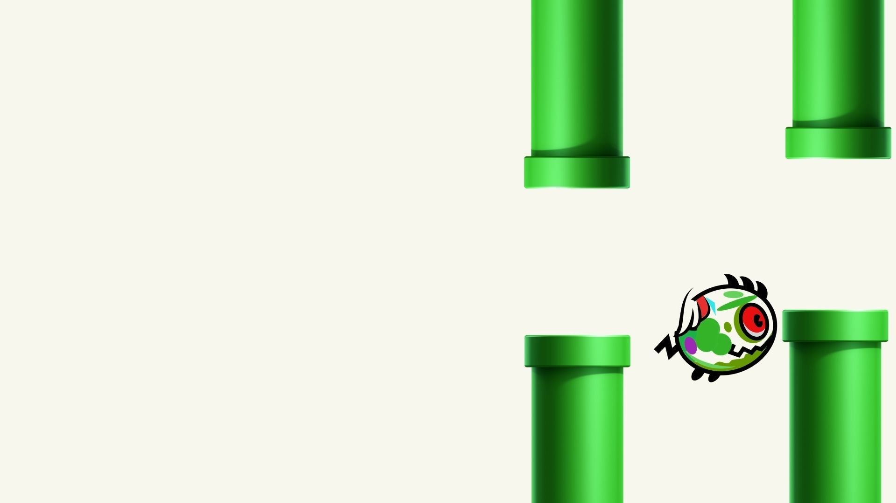
Conclusion
Game development is a long journey….
Slide 10

Slide 23
Any Queries?

